Slide 1
Smart Tool Tracking System
Powered by Galileo

Slide 2
Introduction
Terry Ulery
2.5 years at Intel
Wet Etch (SST)
1270
Shift 4
Navy Veteran
Aviation Electrician
Kevin Halliwell
2.5 years at Intel
Wet Etch (SST)
1265, 1270
Shift 4
Navy Veteran
Avionics Technician

Slide 3

Aviation Background
Tool control was paramount
Poor tool control can lead to mishaps, ranging from damaged equipment to loss of aircraft or life

Slide 4


Consequences

Slide 5
How does this relate to Intel?
Hand tools left in process chambers can result in excursions, damaged equipment, and possibly present a safety hazard
Misplaced tools slow down sustaining activities as time is spent searching for and/or replacing them
Lost tools need to be replaced ($$$)
Current tool control methods are not effective enough

Slide 6
Additional Problems
Many areas have two or three “keyholders” who can access the Listas.
Tools are misplaced and unaccounted for.
Some Listas contain tools which are seldom or never used.
Some areas have one specialty tool that is almost always being used.
Time is spent walking across the fab to Listas that don’t have the tool a technician needs.

Slide 7
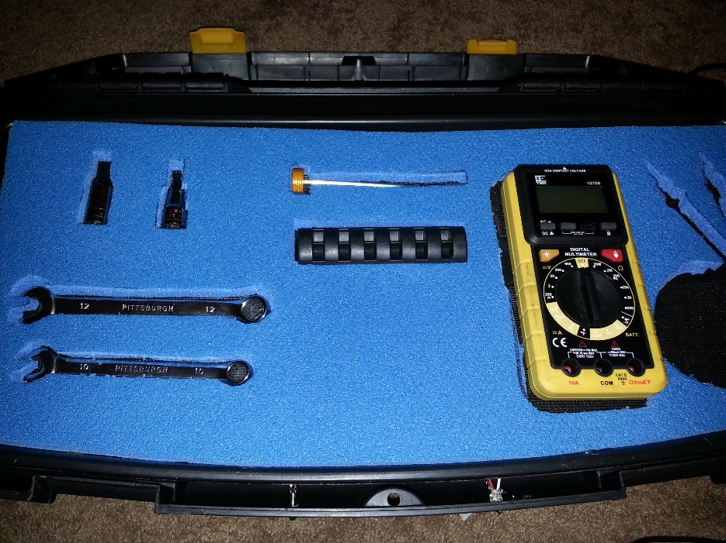
Our Solution
Tool Listas can be equipped with Galileo board and photo transistors.
Listas can be unlocked via smart phone app or SSO RFID wristband.
Tools logged out to WWID that unlocked the Lista.
Lista access can be granted by WWID, managed by Lista owners or designated WPO representatives.
Server tracks all transactions, allows collection and analysis of previously unavailable usage data.

Slide 8
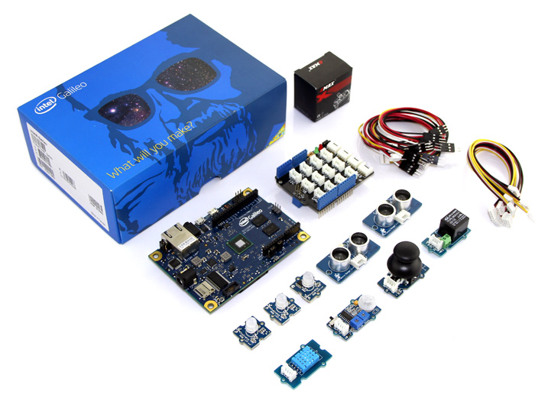
What is Galileo?
Development board enabling “makers” to create projects with a microcontroller
Based upon popular Arduino development board
Utilizes x86 Quark core to enable a full Linux build running “beneath” the Arduino interface – giving makers much more computing power for their applications

Slide 9
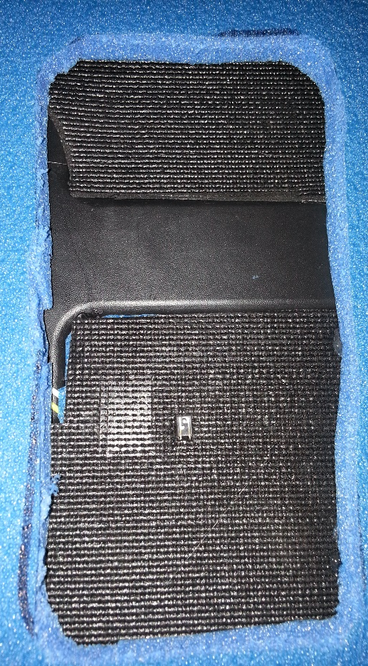
How Does It Work? (Magic)
Pre and post inventory are taken by Galileo flashing LEDs positioned in each drawer, and reading from sensors located under each tool.
Demo version uses ambient light from the room. This would be very problematic for usage in Fab.

Slide 10
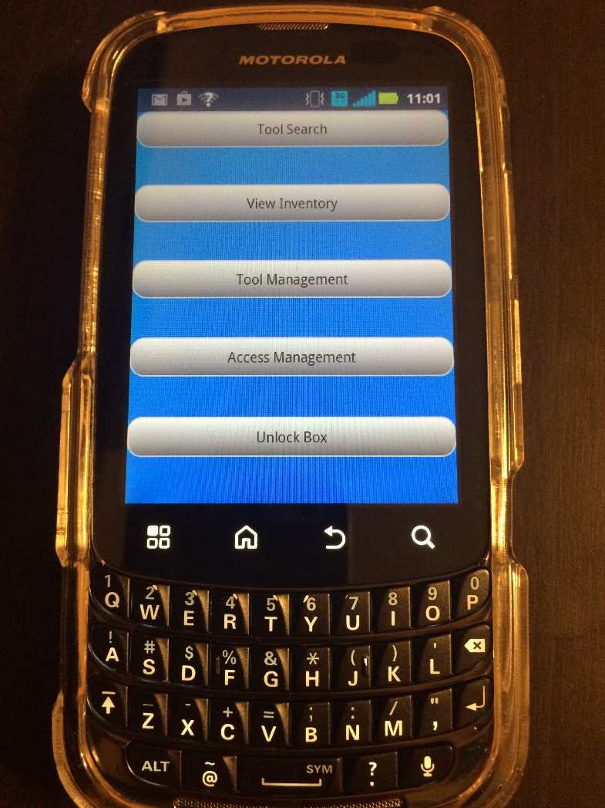
App Features
Tool Search
View Inventory
Tool Management
Access Management
Unlock a Lista

Slide 11

Server Interface (Demo Version)
Command line interface
Displays updated inventory in real time
Allows management of tool boxes, users, etc
Obviously not a solution for use in the fab

Slide 12
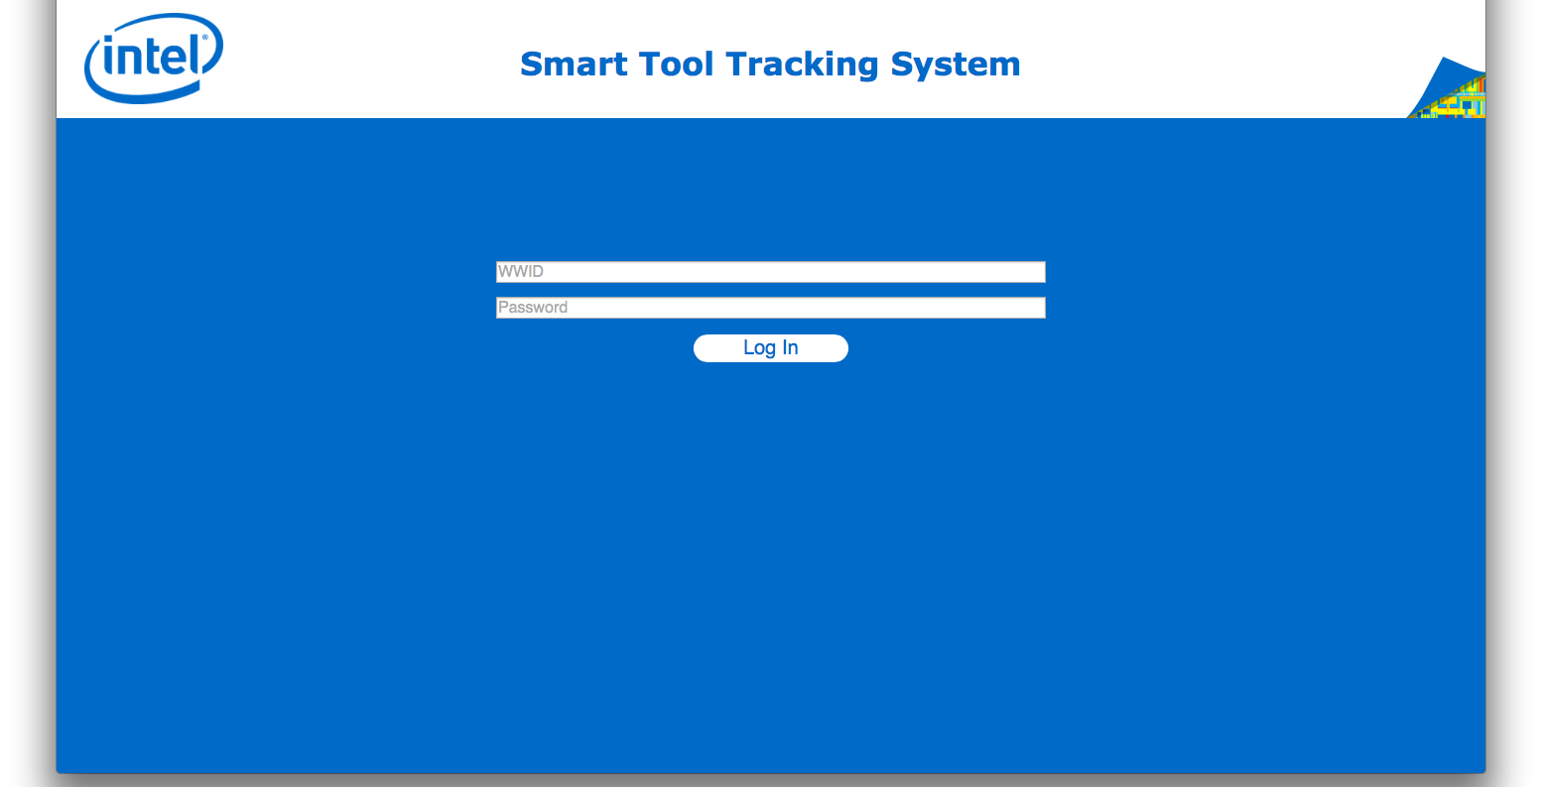
Mockup of Web Interface

Slide 13
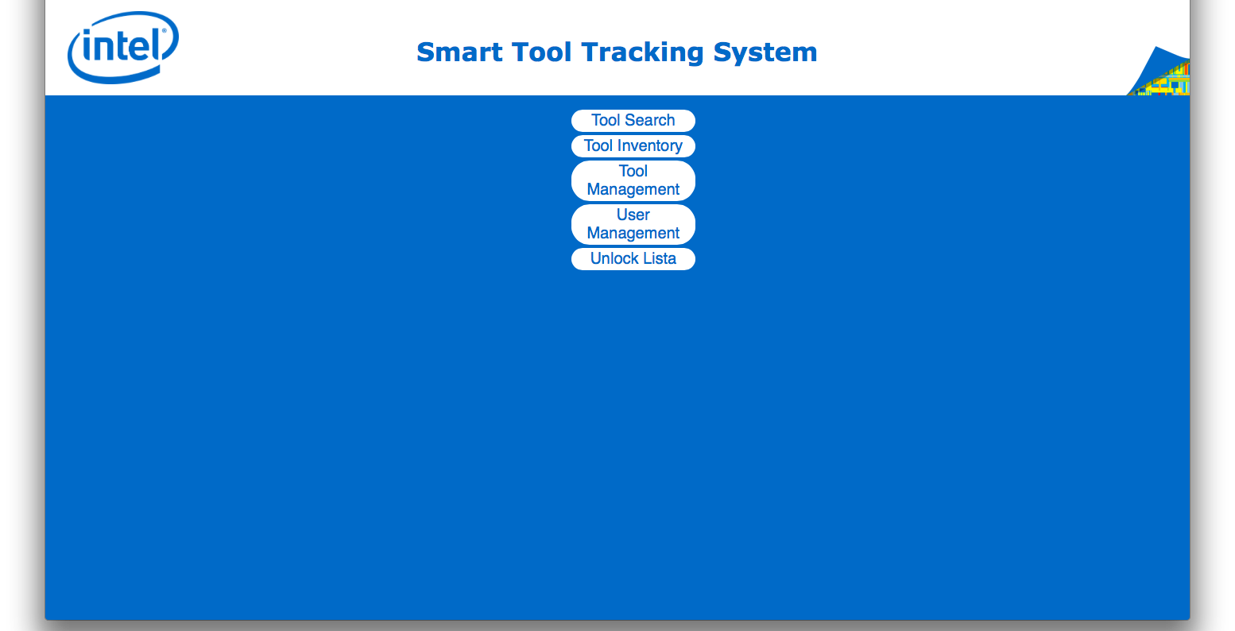
Mockup of Web Interface

Slide 14
Demonstration

Slide 15
Questions?

